Slide 1
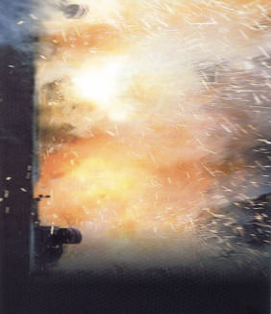
Arc Flash Energy

Slide 2
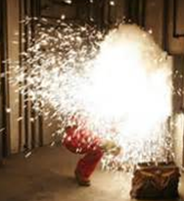
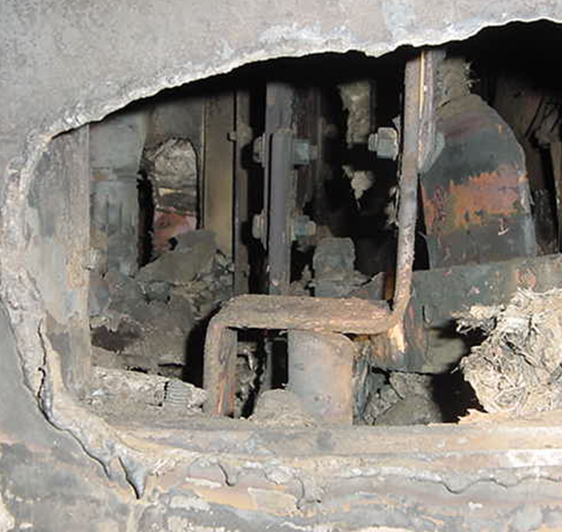
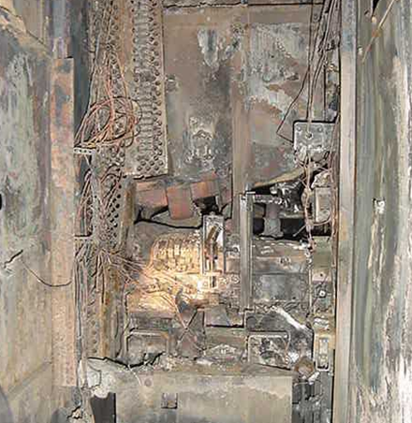
Arc Flash Occurrence
An arc flash is an electrical release of energy hotter than the surface of the sun and capable of exploding with the strength of eight sticks of dynamite.

Slide 3
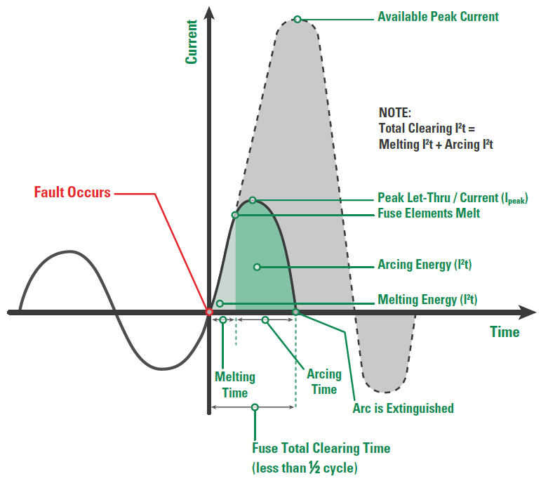
Arc Flash – AC Incident
Current Limitation with a Current-limiting Fuse
Peak Energy Release
Slope based on current limiting fuse
Arcing Energy
Arc Energy Decay
Clearing Time (tA)

Slide 4
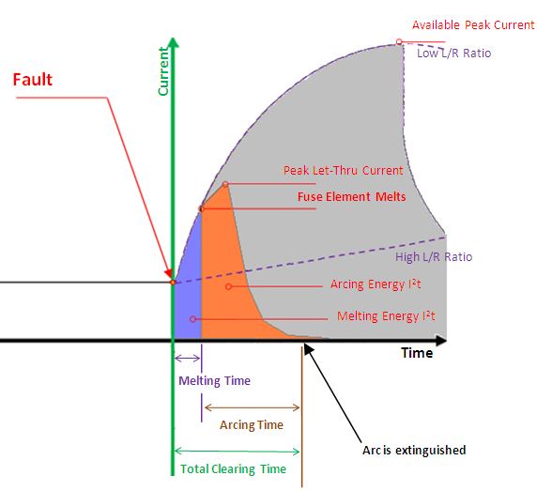
Arc Flash – DC Incident
Current Limitation with a Current-limiting Fuse
Slope based on Inductance
Peak Energy Release
Decay based on Plasma Resistance
Arcing Energy
Clearing Time (tA)

Slide 5
Arc Flash – Incident Energy
Which energy curve is more indicative of an actual curve of an arc flash incident?
Curve based on L/R and tA
Slope based on Inductance
Peak Energy Release
Peak Energy Release
Peak Energy Release
Decay based on Plasma Resistance
Peak Energy Release
Peak Energy Release
Arcing Energy
Clearing Time (tA)
Theoretic:
IE based on area under the curve
All curves express equivalent released IE
Theoretic:
Arcing Energy level not necessarily to scale

Slide 6
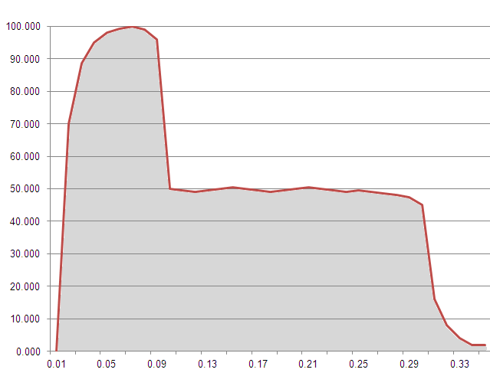
Arc Flash – Incident Energy
Current Limitation with a Current-limiting Fuse
Slope based on Current Limiting
Peak Energy Release
Fuse Element melts
Decay based on Plasma resistance
Plasma conducts current
Plasma Arcing Energy
Clearing Time (tA)
Arc Clears
Arc Energy Decay
Total Incident Energy
Short Occurs

Slide 7
Questions?
Incident Energy Results by cal/cm²
Cal/cm² | Results
0.0033 | Amount of energy the sun produces in 0.1sec. On the ground’s surface at the equator.
1.0 | Equivalent to a finger tip exposed to a cigarette lighter flame for one second
1.2 | Amount of energy that will instantly cause 2nd degree burns to bare skin
4.0 | Amount of energy that will instantly ignite a cotton shirt
8.0 | Amount of energy that will instantly cause incurable 3rd degree burns to bare skin
Should these results be qualified by tA?
If one stood on the equator for 303 days would one receive a burn equivalent to a finger tip exposed to a cigarette lighter flame for one second?
The results are categorized as instantaneous, what is the expected difference as opposed to a 8.0 cal/cm² with a tA of 2 seconds?
You are still getting the same amount of energy, just spread out over a longer period of time.

Slide 8
Questions?
Peak Energy Release
Peak Energy Release
Peak Energy Release
Peak Energy Release
Should we be more concerned with Peak Energy Release?
If we are talking about a tA of 2 S vs. 1 S or 500mS, it seems like a different matter than if it is a tA of 5 mS vs. 10mS or 20mS. It seems logical that tA makes a difference to the pressure of the arc blast.

